Slide 1
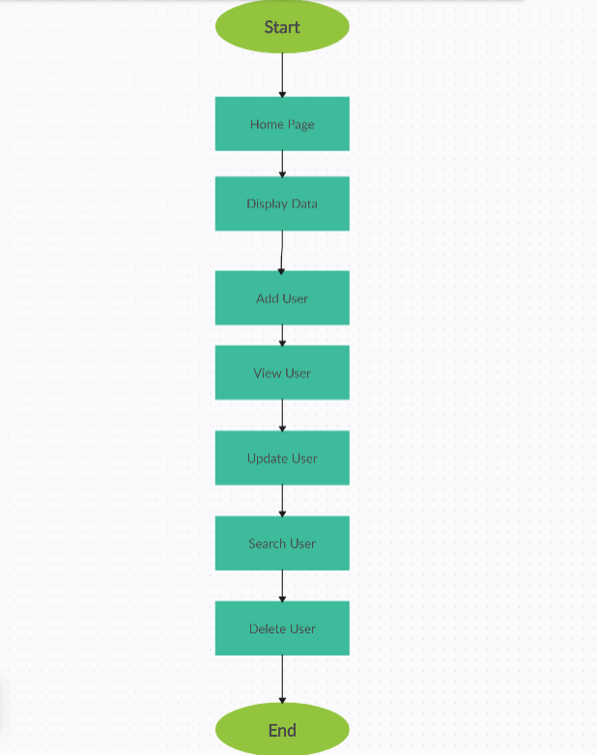

User Management System by Node.js & Express js.
Welcome to our User Management System powered by Node.js! Our system is designed to streamline the process of managing users within your application or organization. With a robust stack leveraging the power of Node.js, along with other complementary technologies, we offer a comprehensive solution for user authentication, authorization, and administration.
RP
by Rohit Phatangare

Slide 2
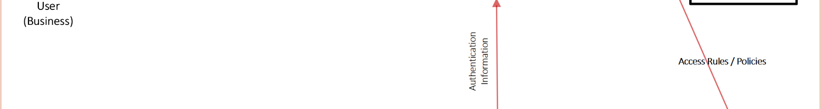
Streamlining User Management
1
Enhanced Security Measures
With the increasing number of cyber threats, implementing robust security measures is imperative. This project provides features such as secure authentication and authorization, helping to protect sensitive user data and prevent unauthorized access.
2
Scalability and Performance
As our organization grows, so does the demand for scalable and high-performing systems. This project, built on Node.js, offers scalability and performance optimizations, ensuring that the user management system can handle increasing user loads without compromising on speed or reliability.
3
Customization and Adaptability
This project was selected for its flexibility and customization options, allowing us to tailor the system to our specific needs and integrate it seamlessly with existing workflows and technologies.

Slide 3
Objective: Key Features
Secure Authentication
Flexible User Roles and Permissions
User Profile Management
Implementing industry-standard authentication mechanisms, we ensure the integrity of user credentials and safeguard against unauthorized access.
Users have the ability to manage their profiles, update personal information, and adjust preferences, enhancing their overall experience and engagement.
Administrators can define custom roles and permissions tailored to the specific needs of their application, allowing for granular control over user access to resources and functionalities.

Slide 4
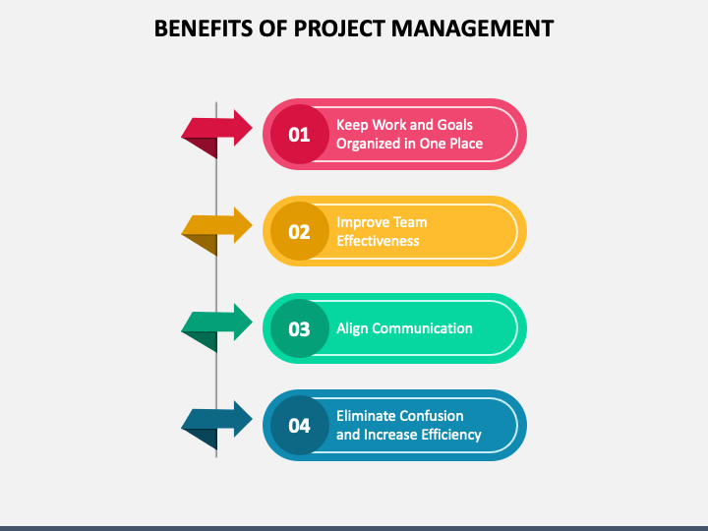
Benefits to surrounding / Society
1
Enhanced Data Security:
Administrators can easily add, modify, or deactivate user accounts, as well as perform bulk operations when necessary, streamlining administrative tasks and reducing overhead.
Improved Efficiency And Productivit
Streamlining administrative tasks such as user registration, account management, and access control leads to greater efficiency and productivity for businesses and organizations. By automating repetitive processes, the system frees up valuable resources and enables staff to focus on more strategic initiatives, thereby fostering economic growth and innovation within the community
Emprovement of User:
Providing users with intuitive interfaces for managing their profiles and preferences empowers them to take control of their digital identities. This promotes transparency, trust, and accountability in online interactions, fostering a sense of empowerment and agency among individuals within the community

Slide 5
Challenges and Benefits
Problem Description
Security Concerns
Without a centralized system in place, user data is often scattered across multiple databases or platforms, leading to redundancies and inconsistencies. This makes it difficult to maintain data integrity and perform accurate analytics.
Storing sensitive user information without proper encryption or access controls exposes organizations to security breaches and compliance risks. Unauthorized access to user data can result in financial losses, legal liabilities, and damage to reputation.
Benefits to the surrounding/society
Improved Efficiency and Productivity
By implementing robust authentication mechanisms and access controls, the User Management System helps protect user data from unauthorized access and breaches. This contributes to a safer digital environment, reducing the risk of identity theft, fraud, and privacy violations within the community.
Streamlining administrative tasks such as user registration, account management, and access control leads to greater efficiency and productivity for businesses and organizations.

Slide 6

Project Category
Project Category
The User Management System project falls under the category of "Enterprise Software" or "Software as a Service (SaaS)" in terms of its project category.

Slide 7
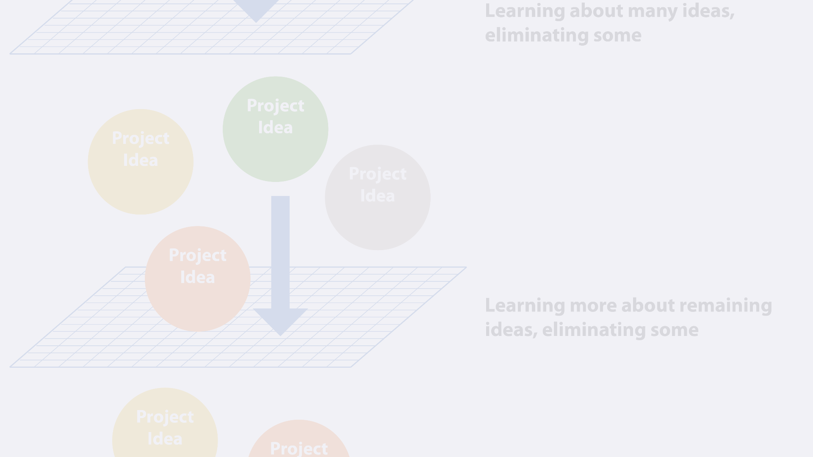
Technical Feasibility
1
Hardware
2
Software
3
Requirements
This application will run on Browser System. The application development maintenance of the project would be very easy.
The System’s Frontend is designed Html-Css-Js Framework-Nodejs and Backend using Mysql.
a. Windows or IOS based device. b. XP of higher Windows version. c. Minimum 8GB RAM.

Slide 8
Future Scope and Conclusion
Future Scope and Future Enhancement
Conclusion
The future scope and potential enhancements for the User Management System project are extensive, reflecting the ongoing evolution of technology and the ever-changing needs of users and organizations.
In conclusion, the User Management System project offers a comprehensive solution for organizations to streamline user data management, enhance security, and improve operational efficiency.

